Slide 1
HPX Workshop (1)
Introduction, Architecture, Hello World
Berkeley C++ Summit 2016

Slide 2
Agenda
How to build HPX
How to build applications using HPX
How to run HPX applications
Architecture of HPX
Examples
Hello world!
The API of HPX
Futures, etc.
Async, etc.
Higher level parallel constructs
Execution policies, executors, parameters, targets
Real world problems
Fibonacci (parallelism for recursive algorithms)
2d stencil (parallelism for iterative algorithms)
Matrix transpose (parallelism for fork-join algorithms)

Slide 3
Getting Started
How To Install HPX

Slide 4
Getting Started
How to install
Prerequisites (recommended, http://stellar-group.github.io/hpx/docs/html/hpx/tutorial/getting_started/prereqs.html)
GNU Compiler Collection (g++) V4.8 or higher
CMake V2.8.4 or higher
Boost V1.50 or higher
HWLOC V1.10 or higher
Download and install HPX
https://github.com/STEllAR-GROUP/hpx
http://stellar-group.github.io/hpx/docs/html/hpx/manual/build_system/building_hpx.html

Slide 5
Getting Started
How to build an application
Using pgk_config: http://stellar-group.github.io/hpx/docs/html/hpx/manual/build_system/using_hpx/pkgconfig.html
Usable with any build system:
export PKG_CONFIG_PATH=$PKG_CONFIG_PATH:$HPX_LOCATION/lib/pkgconfig
c++ -o hello_world hello_world.cpp `pkg-config --cflags --libs hpx_application` -liostreams \ -DHPX_APPLICATION_NAME=hello_world
Using CMake: http://stellar-group.github.io/hpx/docs/html/hpx/manual/build_system/using_hpx/using_hpx_cmake.html
Example with minimal cmake build system:
add_executable(hello_world_example hello_world.cpp)
hpx_setup_target(hello_world_example)

Slide 6
Overview of HPX

Slide 7
HPX – A C++ Standard Library
A C++ Standard Library for Concurrency and Parallelism
Exposes a coherent and uniform, standards-oriented API for ease of programming parallel, distributed, and heterogeneous applications.
Enables to write fully asynchronous code using hundreds of millions of threads.
Provides unified syntax and semantics for local and remote operations.
HPX represents an innovative mixture of
A global system-wide address space (AGAS - Active Global Address Space)
Fine grain parallelism and lightweight synchronization
Combined with implicit, work queue based, message driven computation
Full semantic equivalence of local and remote execution, and
Explicit support for hardware accelerators (through percolation)

Slide 8
HPX – A C++ Standard Library
Widely portable
Platforms: x86/64, Xeon/Phi, ARM 32/64, Power, BlueGene/Q
Operating systems: Linux, Windows, Android, OS/X
Well integrated with compiler’s C++ Standard libraries
Enables writing applications which out-perform and out-scale existing applications based on OpenMP/MPI
http://stellar-group.org/libraries/hpx
https://github.com/STEllAR-GROUP/hpx/
Is published under Boost license and has an open, active, and thriving developer community.
Can be used as a platform for research and experimentation

Slide 9
HPX – A C++ Standard Library
Policy Engine/Policies
API
C++1y Concurrency/Parallelism APIs
Threading Subsystem
Local Control Objects
(LCOs)
Performance Counter Framework
Active Global Address
Space (AGAS)
Parcel Transport Layer
OS

Slide 10
What about Lightweight Threads?
It's the job of the operating system to manage 'hardware level' or 'kernel level' OS threads.
OS threads are expensive to create/destroy
OS threads take a time slice of CPU time
Creating too many of them can hamper performance
On Startup HPX creates one 'worker' thread per core
On each hardware thread, HPX runs its own Task Scheduler.
HPX (Threads)/Tasks are executed on the HPX worker thread
which is really an OS thread
(you must be careful not to block the underlying thread - if you do, no tasks can run on it)
each HPX 'task' is referred to as a lightweight thread

Slide 11
Advantage of Lightweight Threads
The philosophy behind lightweight threads is to switch from one task to another as quickly as possible as soon as anything
finishes
needs to wait (suspend)
Suspended tasks
Many tasks can run on the same worker thread (one after another)
or intermixed as one task suspends and another resumes
HPX does not ever interrupt your task directly
the OS worker thread may be suspended as it loses its time slice
the HPX task running at the time is therefore suspended
other (dependent) tasks might in turn suspend
Many small tasks are the key to success
with minimal dependencies on other tasks (if possible)
not too small (overheads of management), not too big (starvation of worker threads)
enough tasks in the queue helps ensure that no CPU cycles are wasted

Slide 12
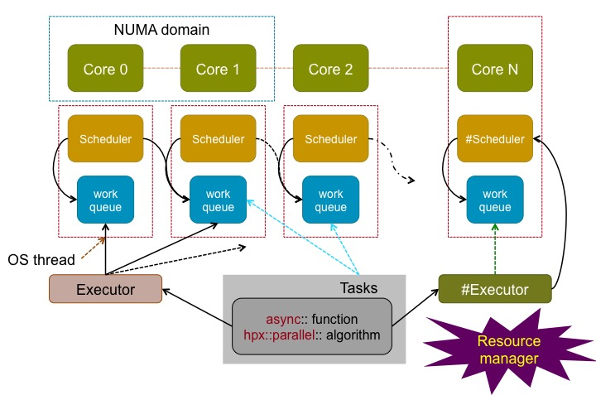
HPX Runtime Schematic

Slide 13
Thread Overheads

Slide 14
HPX Runtime
Similar to OpenMP/TBB, but ...
OpenMP has parallel regions where a thread pool executes your loops/tasks
outside those regions, code runs as usual (on normal 'OS threads')
TBB does not allow for your tasks to be suspended
With HPX, the runtime is always active
the runtime is started on program startup
it stays active until program termination
there are no parallel regions
everything is running on an HPX thread
everything is part of a task
Disclaimer
you can manually start/stop the runtime (if you really want to)

Slide 15
HPX is a (only a) library
It's implemented as a C++ library/framework
provides threads/futures/locks/schedulers/etc
allows the user to ignore the threads/schedulers/locks
gives the user control over them too
The user doesn't manage threads directly (usually)
user creates tasks
synchronizes between/amongst them
shouldn't need to worry about low level synchronization primitives
(but sometimes needs to)
The runtime does its best to schedule tasks
but it can be abused easily
either by accident (careless programming)
or deliberately
A good understanding of how it all works really helps

Slide 16
Synchonization with futures
The principal means of synchronization in HPX is the future<T>
A future is the result of something that hasn't yet run
A future is set by one thread/task
using future.set_value(stuff);
The value is retrieved by another thread/task
using auto value = future.get(); syntax
Futures in HPX are extended to support continuations
future2 = future1.then(something_else);
And when_xxx(one_or_more_futures) syntax
From these building blocks one can make complex DAGs

Slide 17
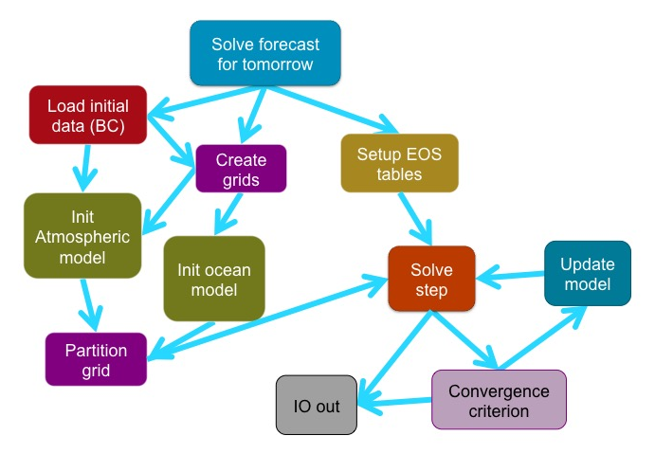
Task Based Programming
A different approach to writing your code
your program should be a tree of tasks
each task will depend on other tasks
and have child tasks
You don't have to have the same on all nodes (c.f. MPI)
Each one of these boxes will contain a sub-tree of (possibly millions) of tasks

Slide 18
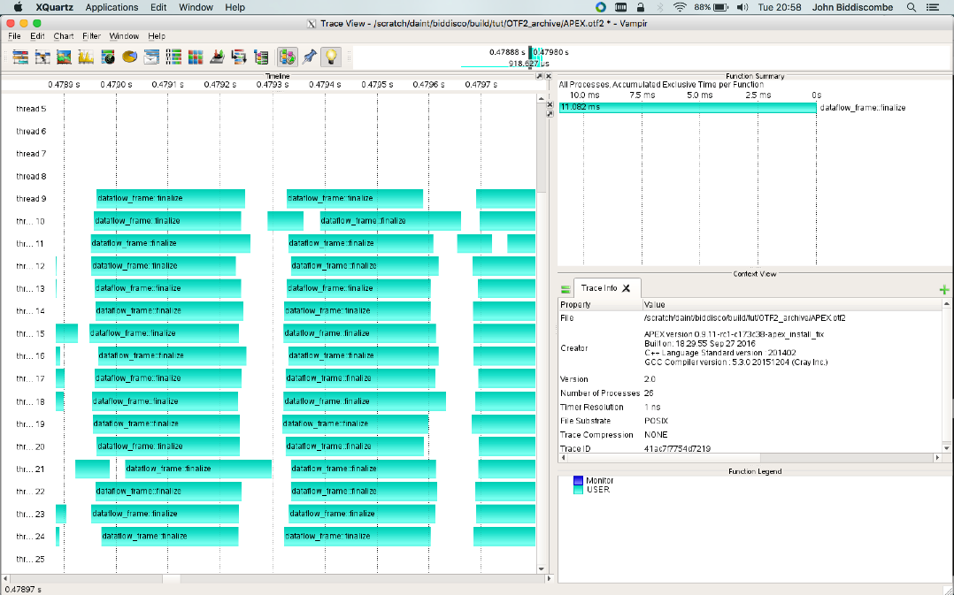
The Goal with Tasks
Make these gaps as small as possible
Keep breaking tasks into smaller tasks so the scheduler can fill gaps
limit of task size/granularity is a function of overheads
context switch (actually swapping stack, registers etc)
time to create, queue, dequeue a task

Slide 19
Task Decomposition
Breaking a program into tasks should be straightforward
More functional
tasks should accept inputs and return results
modifying global state should be avoided
race conditions and other thread related problems (deadlocks etc)
The leaf nodes of the tree are the smallest bits of work you can express
but those leaf nodes might be broken further by HPX
even parallel::for(...) loops decompose into tasks
all parallel::algorithm's are made up of tasks
HPX differs from (most) other libraries because the same API and the same scheduling/runtime can be used for the whole hierarchy of tasks
We aim to replace OpenMP+MPI+Acc with a single framework
based soundly on C++
from top to bottom (of the task tree)

Slide 20
Task Scheduling and Lifetime
Each task goes onto one of the schedulers
where a task goes is controlled by executors
schedulers maintain a high priority and normal queue
schedulers can steal (some do, some don't)
you can choose a scheduler when you create an executor
Tasks can be
Running : context is active, code is running as it would on native thread
Suspended : task ran, but then had to wait for something
Staged : task has been created, but cannot be run yet
Pending :it is ready to run, but waiting in a queue
Terminated : awaiting cleanup

Slide 21
Suspended Tasks
A task that is running requires a value from a future
the future is not ready :(
auto val = future.get() would block (if we were not HPX)
the current task cannot progress so it changes state to suspended
the scheduler puts it into the suspended list
the future that was needed has the suspended task added to its internal (shared state) waiting list
when that future become ready, the task will be changed to pending
and go back onto the queue so that when a worker is free, it can run
The same process happens when a task tries to take a lock but can't get it
The shared state inside the mutex will notify the task and do the 'right thing'
This is one reason why all the std::thread, std::mutex etc code has been reimplemented

Slide 22
Staged Tasks
Like a suspended task, but it hasn't run yet
A staged task is what exists when a continuation or when_xxx creates a task but it can't run until the dependencies are satisfied
It's a suspended task that hasn't yet started
When is the task actually created?
When the code that instantiates it is executed
Inside continuations this might be when another task completes
future.then(another_task.then(more_tasks));
Outside continuations it can be 'up-front'
a loop generating futures and attaching to previous iterations future[i] = future[i-1].then(another_task);
it can be confusing

Slide 23
Active Messages
MPI uses send/receive
(it has one sided RMA too)
there is an implied synchronization between the endpoints
HPX uses active messages
a remote function invocation + arguments
the arguments are the 'message' data
A remote function invocation creates a task on the remote node
the task goes into the queue of the remote node
it is no different to any other task
it might not have any relation to other tasks running there
it can synchronize with other tasks

Slide 24
Structure of an Application
You can write an HPX application that only starts on locality 0
meaning int main runs on locality 0 but other nodes just sit in a waiting loop
node 0 triggers a do_work action on remote nodes
how you coordinate these tasks is up to you
OTOH, one can write an HPX application that starts on all localities (like MPI does
SPMD (single program, multiple data) mode
You can run different binaries on different nodes
providing the actions on each node match up
Different platforms on different nodes are supported
but unlikely to be used for most of our HPC codes

Slide 25
Where does HPX end and your code starts
HPX has a runtime
Everything is a task (at some level)
HPX provides a parallel STL ... and parallel for etc
for_loop(par.with(static_chunk_size()), 0, hpx::get_os_thread_count(),
// For each element in the range, call the following lambda
[id](std::size_t num_thread)
{
std::cout << "Hello, I am HPX Thread " << num_thread
<< " executed on Locality " << id << std::endl;
});
We are still writing C++, but how much is our code any more

Slide 26
Some Simple Examples
A Closer Look

Slide 27
Hello HPX World
#include <hpx/hpx.hpp>
#include <hpx/hpx_init.hpp>
#include <hpx/iostream.hpp>
int hpx_main()
{
hpx::cout << "Hello HPX World!\n";
return hpx::finalize();
}
int main(int argc, char* argv[])
{
return hpx::init(argc, argv); // pass along command line arguments
}

Slide 28
Simplest Hello HPX World
#include <hpx/hpx.hpp>
#include <hpx/hpx_main.hpp> // <<- NOTE THIS
#include <hpx/iostream.hpp>
int main(int argc, char* argv[])
{
hpx::cout << "Hello HPX World!\n";
return 0;
}

Slide 29
Hello HPX World
HPX applications start with executing hpx_main
Different signatures possible
int hpx_main();
int hpx_main(int argc, char* argv[]);
int hpx_main(boost::program_options::variables_map& vm);
By default hpx_main is executed on main locality only
It is possible to force execution on all localities (easiest: --hpx:run-hpx-main)
HPX applications support many predefined command line options
All predefined command line options follow scheme: --hpx:<opt> [arg]
Get a list by invoking: ‘./app --hpx:help’ (or simply ‘./app -h’)
See: http://stellar-group.github.io/hpx/docs/html/hpx/manual/init/commandline.html

Slide 30
Hello HPX World
HPX is initialized by invoking hpx::init()
Must be called on all localities
This will
Initialize the runtime system
Register every locality with the main locality
Schedule hpx_main() as the first HPX thread
Wait for the whole system to shutdown (triggered by hpx::finalize())
HPX is told to (gracefully) shut down by invoking hpx::finalize()
Can be called on any locality, first invocation triggers exit (must be called at least once)
This will
Wait for all activity (system wide) to cease
Releases main threads waiting inside hpx::init()

Slide 31
Hello Distributed HPX World
void say_hello()
{
hpx::cout << "Hello HPX World from locality: "
<< hpx::get_locality_id() << "!\n";
}
HPX_PLAIN_ACTION(say_hello); // defines say_hello_action
int hpx_main()
{
say_hello_action sayit;
for (auto loc: hpx::find_all_localities())
hpx::apply(sayit, loc);
return hpx::finalize();
}

Slide 32
Hello Distributed HPX World
HPX applications can be run in different ways
Using PBS:
echo "pbsdsh -u <hpx-app> <app-options> \ --hpx:nodes=`cat $PBS_NODEFILE`" > ./pbs_script.sh
qsub <qsub-options> ./pbs_script.sh
Using SLURM:
srun <srun-options> <hpx-app> <app-options>
Using MPI (if MPI parcel-port is enabled)
mpiexec <mpiexec-options> <hpx-app> <app-options>
Locally:
<hpx-app> <app-options> -0 --hpx:localities=2 &
<hpx-app> <app-options> -1

Slide 33
Hello Distributed HPX World
int hpx_main()
{
std::vector<hpx::future<void>> ops;
say_hello_action sayit;
for (auto loc: hpx::find_all_localities())
ops.push_back(hpx::async(sayit, loc));
hpx::wait_all(ops);
return hpx::finalize();
}

Slide 34
Hello Distributed HPX World
Full example code see https://github.com/STEllAR-GROUP/tutorials/blob/master/examples/00_hello_world/hello_world.cpp

Slide 35




